Slide 1
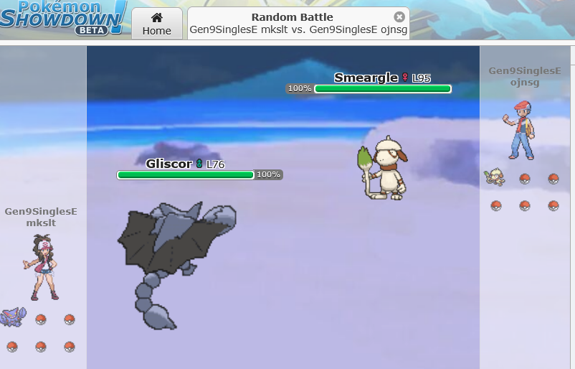
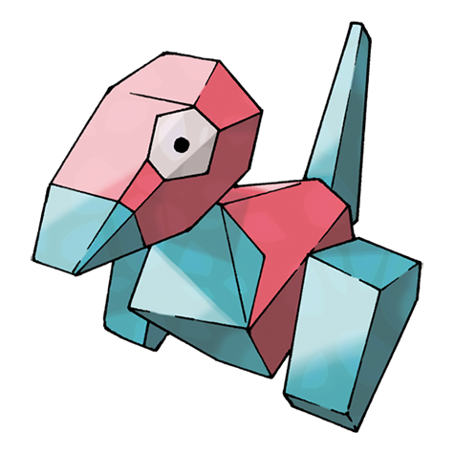
Porygon-RL: A Pokemon Showdown Reinforcement Learning Agent
RL

Slide 2
Motivation & Overview
Showdown Servers
I wanted to pick a topic that aligned with my interests, and when I found Pokemon Showdown open source I thought it fit perfectly.
Poke-env was used to communicate with Showdown servers
Gymnasium was used to build the RL environment
Stable-Baselines3 was used to build the DQN agent
Gymnasium Env
Poke Env
Poke Env
DQN Agent

Slide 3
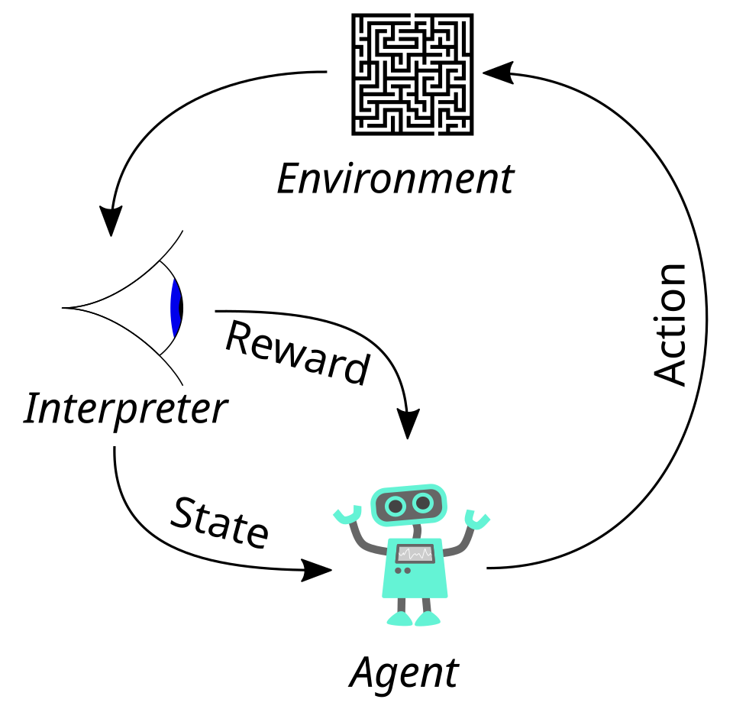
Reinforcement Learning & DQN
Framed each battle as a MDP
(s, a, p(s’|s, a), R(s|a), 𝛾)
Q-values were calculated using a Deep Q- Network.
Loss is calculated against:
y = r + 𝛾argmaxQ(s', a')

Slide 4
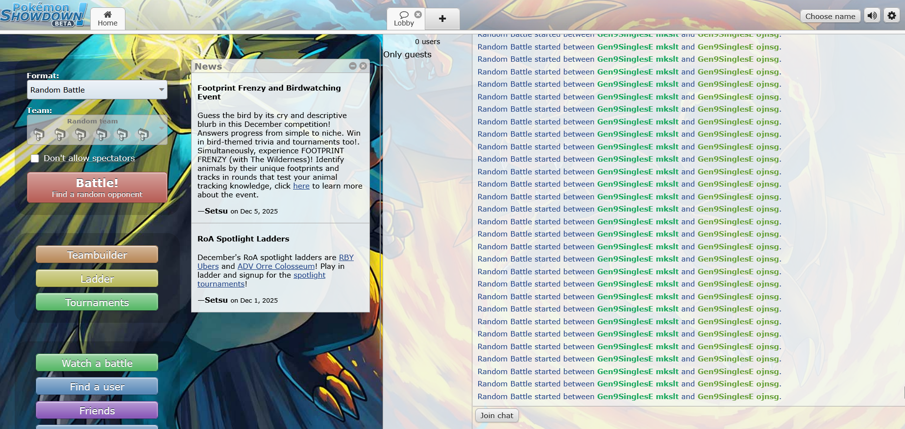
Environment Setup & Reflex Agents
Local server was set up using Node.JS. And Simple Reflex Agents were built as training partners.
Random Agent | Max Damage Agent
Given a state s. Picks a random move in the action space a | Given a state s. Picks action a that does the highest damage.

Slide 5
Slide 5 – Initial State & Action Representation (v1)
Observation space was kept as a simple 10d-state including: Basepower of each move, type multiplier of each move. And fraction of pokemon remaining on each side.
s=[BP1, BP2, BP3, BP4, TMult1, TMult2, TMult3, TMult4, Our Pkmn Remaining, Opp pkm remaining]
Action space was kept as a set of discrete actions {1 .. 26}.
Rewards were kept simple: +10 for winning (-10 for losing), +-2 for fainting a pokemon, +- %hp dealt/taken for damage.
Results were mixed: R = 9.53 +/- 7.07, for Random Agent, R = -1.49 +/- 8.6. For Max Damage

Slide 6
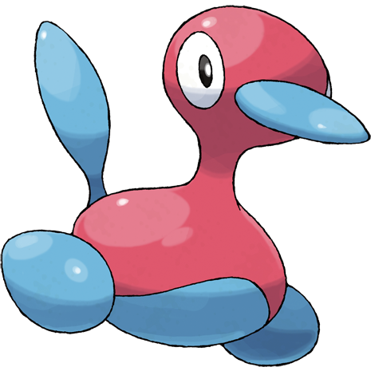
Upgrades: Porygon2-RL
Upgrades:
Expanded Observation Space
Implemented Action Mask
Improved Reward Function
Built Training Curriculum
Boosted Network Architecture
Added Win Rate for evaluation
RL

Slide 7
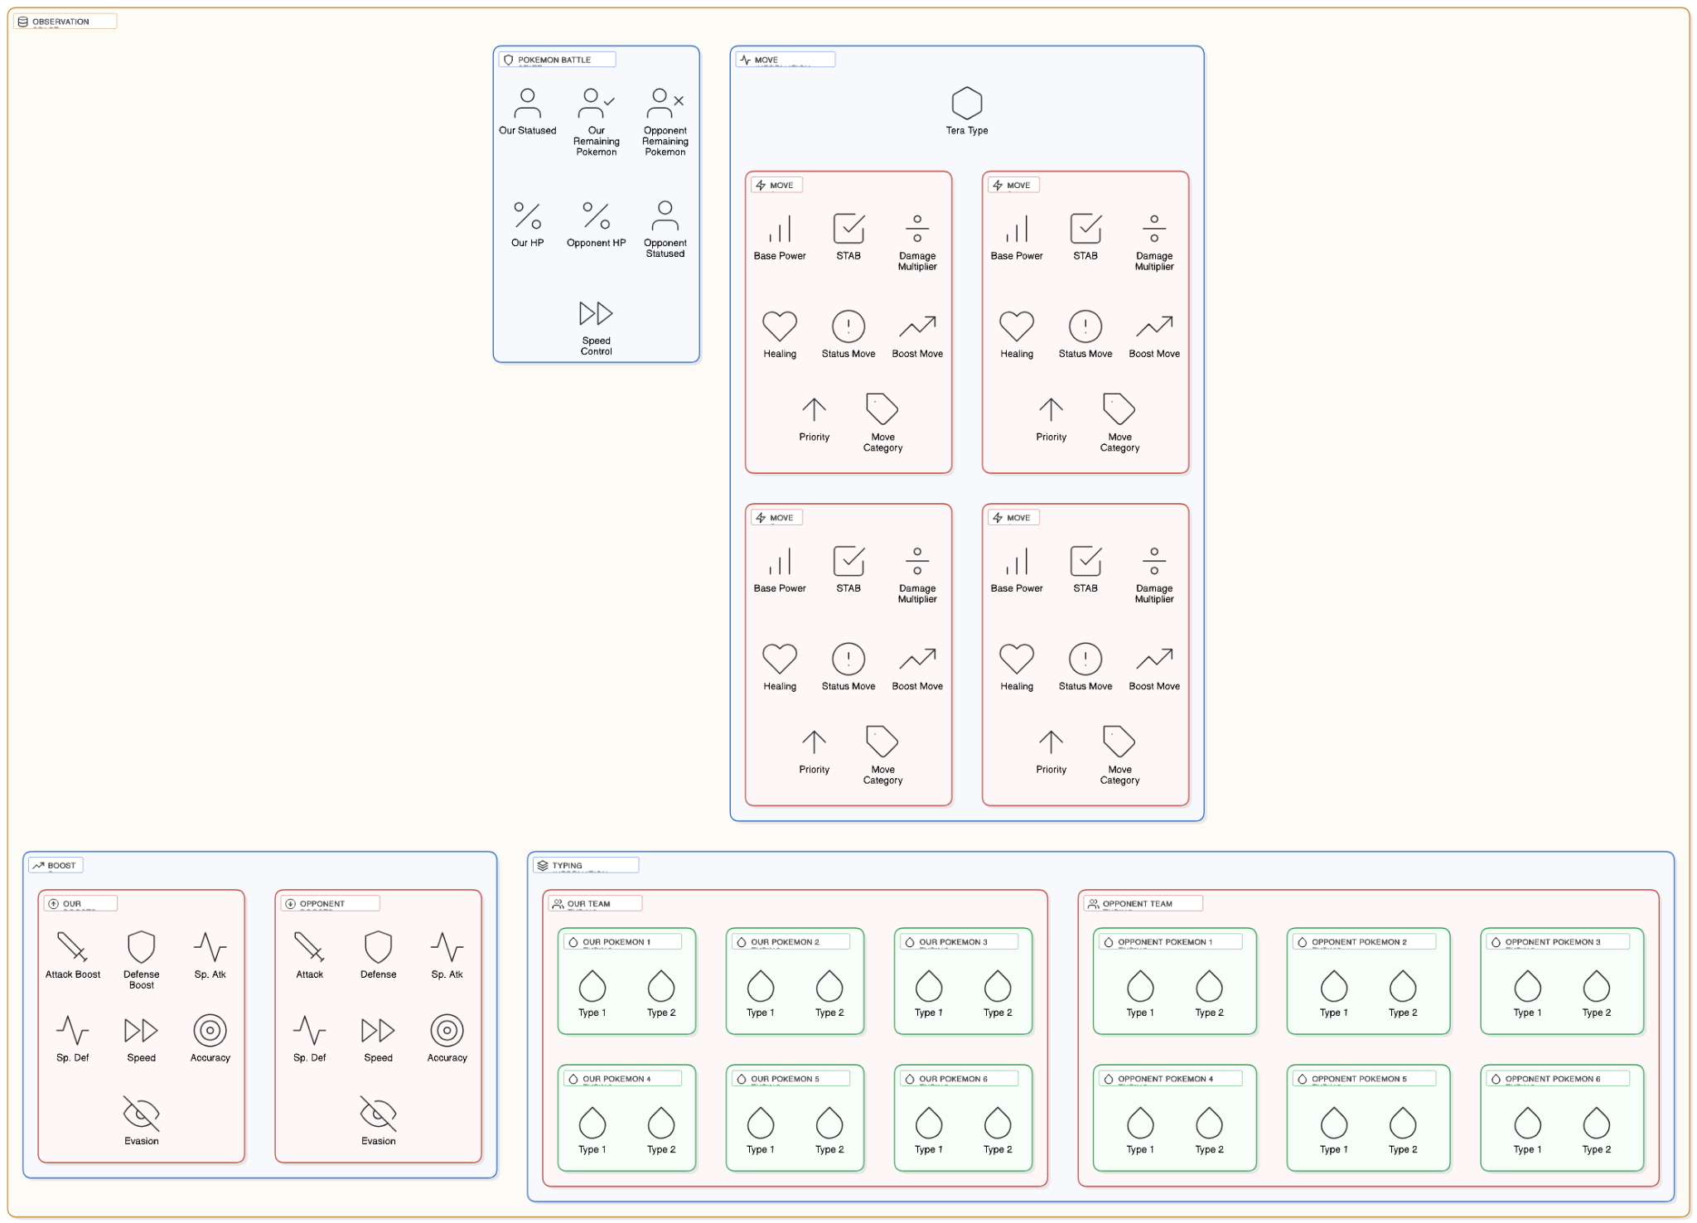

Slide 8
Action Mask + New Rewards
Built action mask and implemented it via reward function
0 1 0 1 1 0 1 0 1 1 0 0 0 0 1 1 1
Added reward shaping: Increased value for fainted and reward to make more aggressive. Slight negative rewatch for switching, Reward for using super effective moves, negative reward for using not very effective moves

Slide 9
Implemented training Curriculum
Built a Training Curriculum that works as follows: Starts with Random Agent (100k steps) -> Mixed Agent (100K steps) -> Max Damage Agent (300k steps)
Random Agent
Mixed Agent
Mixed Agent
For each episode: Sample random variable Z with probability P(Z=1) = p, P(Z=0) = 1-p. If Z = 1 use policy for Random Agent, if Z=0 use policy for Mixed Agent.
Max Damage Agent

Slide 10
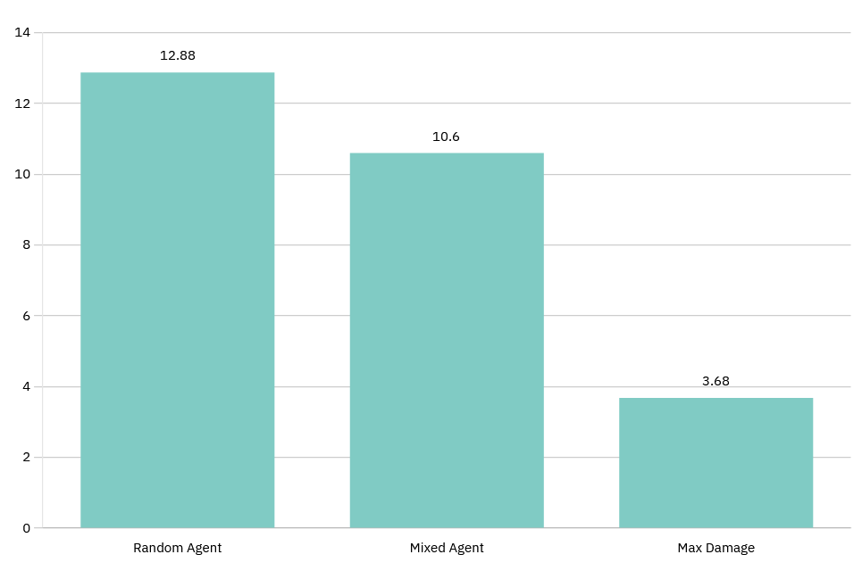
Results & Observations
Win Rate for Random Agent: 100% Win Rate for Mixed Agent: 95% Win Rate for Max Damage Agent: 70%

Slide 11
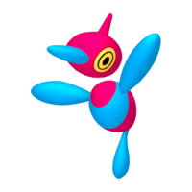
Limitations + Final Reflections and future directions
Limitations and reflections:
Limited Documentation
RL may not be the best approach for this problem
Limited Time Step count
Future Ideas:
Self Play
Expanded Observation Space
Play against Real Players
Search Algorithm Agent
Future
RL

Slide 12


Slide 13
References + Images:
Porygon artwork (image 1)
Unknown artist. Porygon artwork ImageImageImage. Google-hosted thumbnail. Retrieved December 7, 2025, from
https://encrypted-tbn0.gstatic.com/images?q=tbn:ANd9GcTXyypcG4qtUFScv-xo7UNzvqdEyAHhb40w4Q&s
Porygon official art (high-res) The Pokémon Company. Porygon official artwork ImageImageImage. Pokémon Wiki (Fandom). Retrieved December 7, 2025, from https://static.wikia.nocookie.net/pokemon/images/8/8e/0137Porygon.png/revision/latest/scale-to-width-down/1200?cb=20240724205447
Bar chart generator tool Draxler. Bar Chart Generator WebtoolWeb toolWebtool. Retrieved December 7, 2025, from https://www.draxlr.com/tools/bar-chart-generator/
Diagram tool Eraser. DiagramGPT – Diagramming Tool WebtoolWeb toolWebtool. Retrieved December 7, 2025, from https://www.eraser.io/diagramgpt
Porygon2 artwork The Pokémon Company. Porygon2 official artwork ImageImageImage. Bulbagarden Archives. Retrieved December 7, 2025, from https://archives.bulbagarden.net/media/upload/b/b8/0233Porygon2.png
Reinforcement learning diagram Unknown author. Reinforcement learning agent–environment loop DiagramDiagramDiagram. Wikimedia Commons. Retrieved December 7, 2025, from https://upload.wikimedia.org/wikipedia/commons/thumb/1/1b/Reinforcement_learning_diagram.svg/500px-Reinforcement_learning_diagram.svg.png
Porygon-Z artwork
The Pokémon Company. Porygon-Z HOME artwork ImageImageImage. Bulbagarden Archives. Retrieved December 8, 2025, from
https://archives.bulbagarden.net/media/upload/thumb/b/b6/HOME0474.png/200px-HOME0474.png
Stable-Baselines3 documentation
Stable-Baselines3 Contributors, Stable-Baselines3 Documentation. Available at: https://stable-baselines3.readthedocs.io/en/master/ (accessed 7 Dec. 2025).
Node.js Node.js Foundation, Node.js – JavaScript Runtime. Available at: https://nodejs.org/en/
(accessed 7 Dec. 2025).
poke-env library H. Sahovic, poke-env: A Python Environment for Pokémon Showdown Bots, GitHub repository. Available at: https://github.com/hsahovic/poke-env
(accessed 7 Dec. 2025).
Pokémon type chart Pokémon Database, Type Chart. Available at: https://pokemondb.net/type
(accessed 7 Dec. 2025).
Mirkin (1996) – clustering book B. G. Mirkin, Mathematical Classification and Clustering. New York, NY: Springer, 1996.
CurriculumNet paper S. Guo, W. Huang, H. Zhang, C. Zhuang, D. Dong, M. R. Scott, and D. Huang, “CurriculumNet: Weakly Supervised Learning from Large-Scale Web Images,” arXiv preprint arXiv:1808.01097, 2018.
Deep Q-Learning article (GeeksforGeeks) GeeksforGeeks, “Deep Q-Learning,” GeeksforGeeks. Available at: https://www.geeksforgeeks.org/deep-learning/deep-q-learning/
(accessed 7 Dec. 2025).
Hinkelmann neural networks notes K. Hinkelmann, “Neural Networks,” University of Applied Sciences Northwestern Switzerland, lecture notes, 2018. (Originally available as a PDF; archived and retrieved 6 Oct. 2018.)

